Slide 1
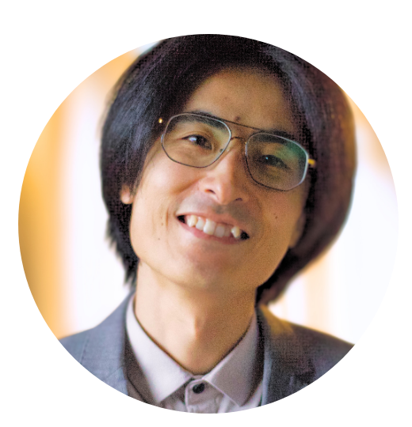



Do yourself a favor and use Git
Nami Sunami
Data Steward | TU Eindhoven
n.sunami@tue.nl
DOI: 10.53962/s57e-jc4q
This work is marked with CC0 1.0

Slide 2
4 years ago…

Slide 3

I was doing my PhD, and I wanted to make a reproducible paper

Slide 4

So, I started a git and GitHub repo
github.com/nsunami/dissertation

Slide 5
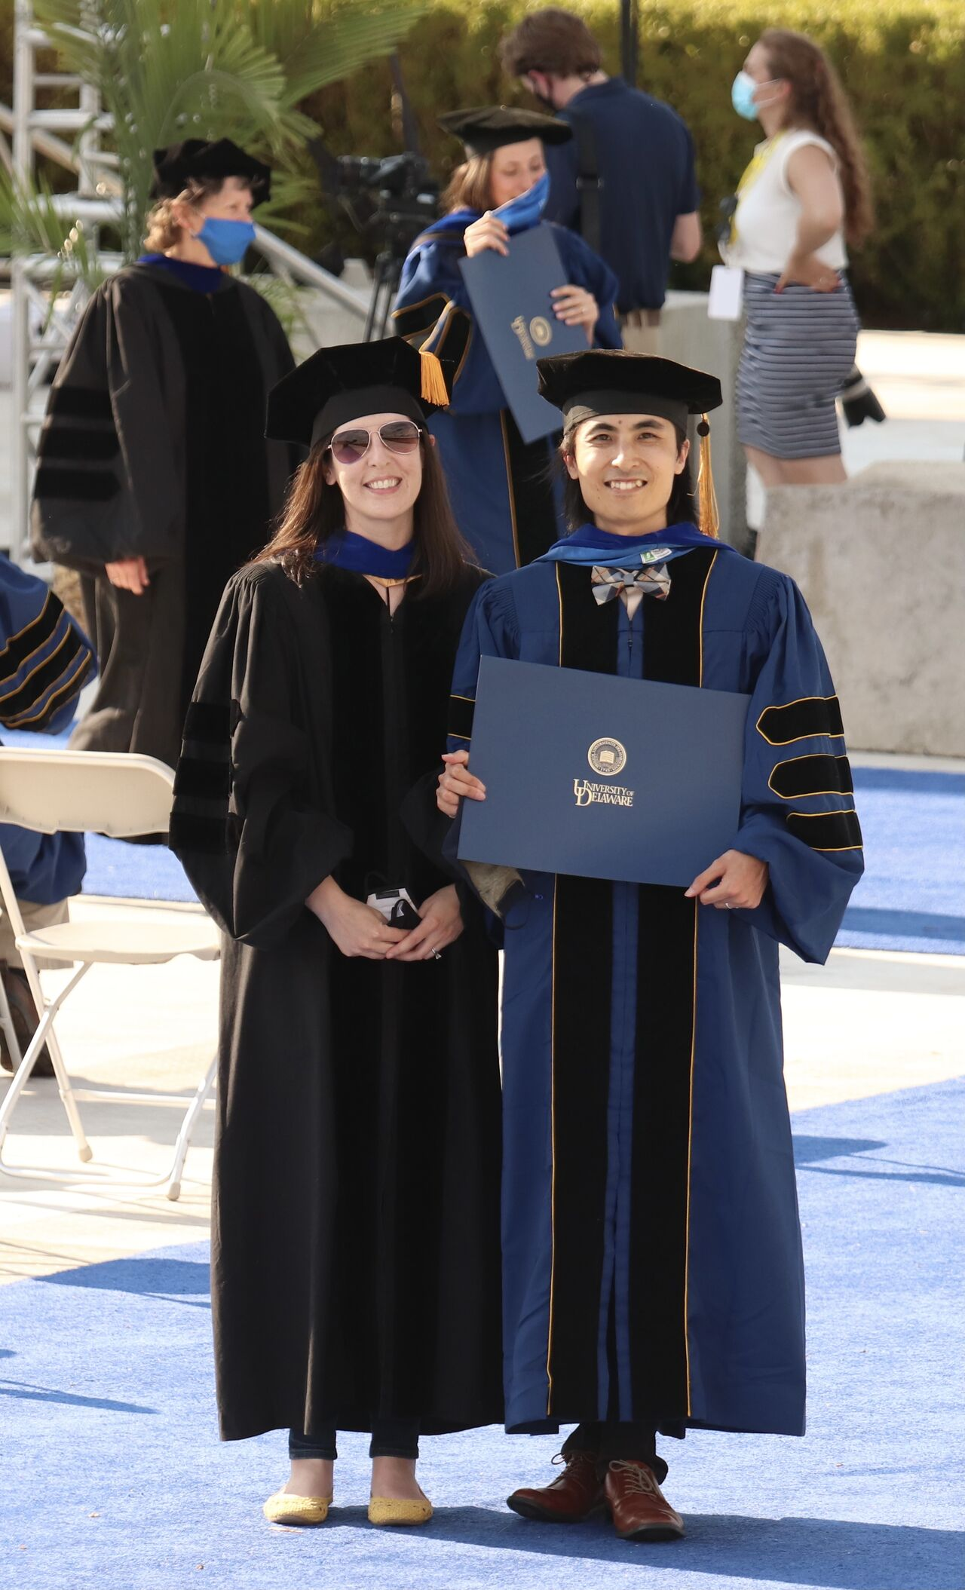
In 2022, I finished my dissertation.
I was proud!

Slide 6
Years have passed…

Slide 7
I tried to run my dissertation. Did it run?

Slide 8
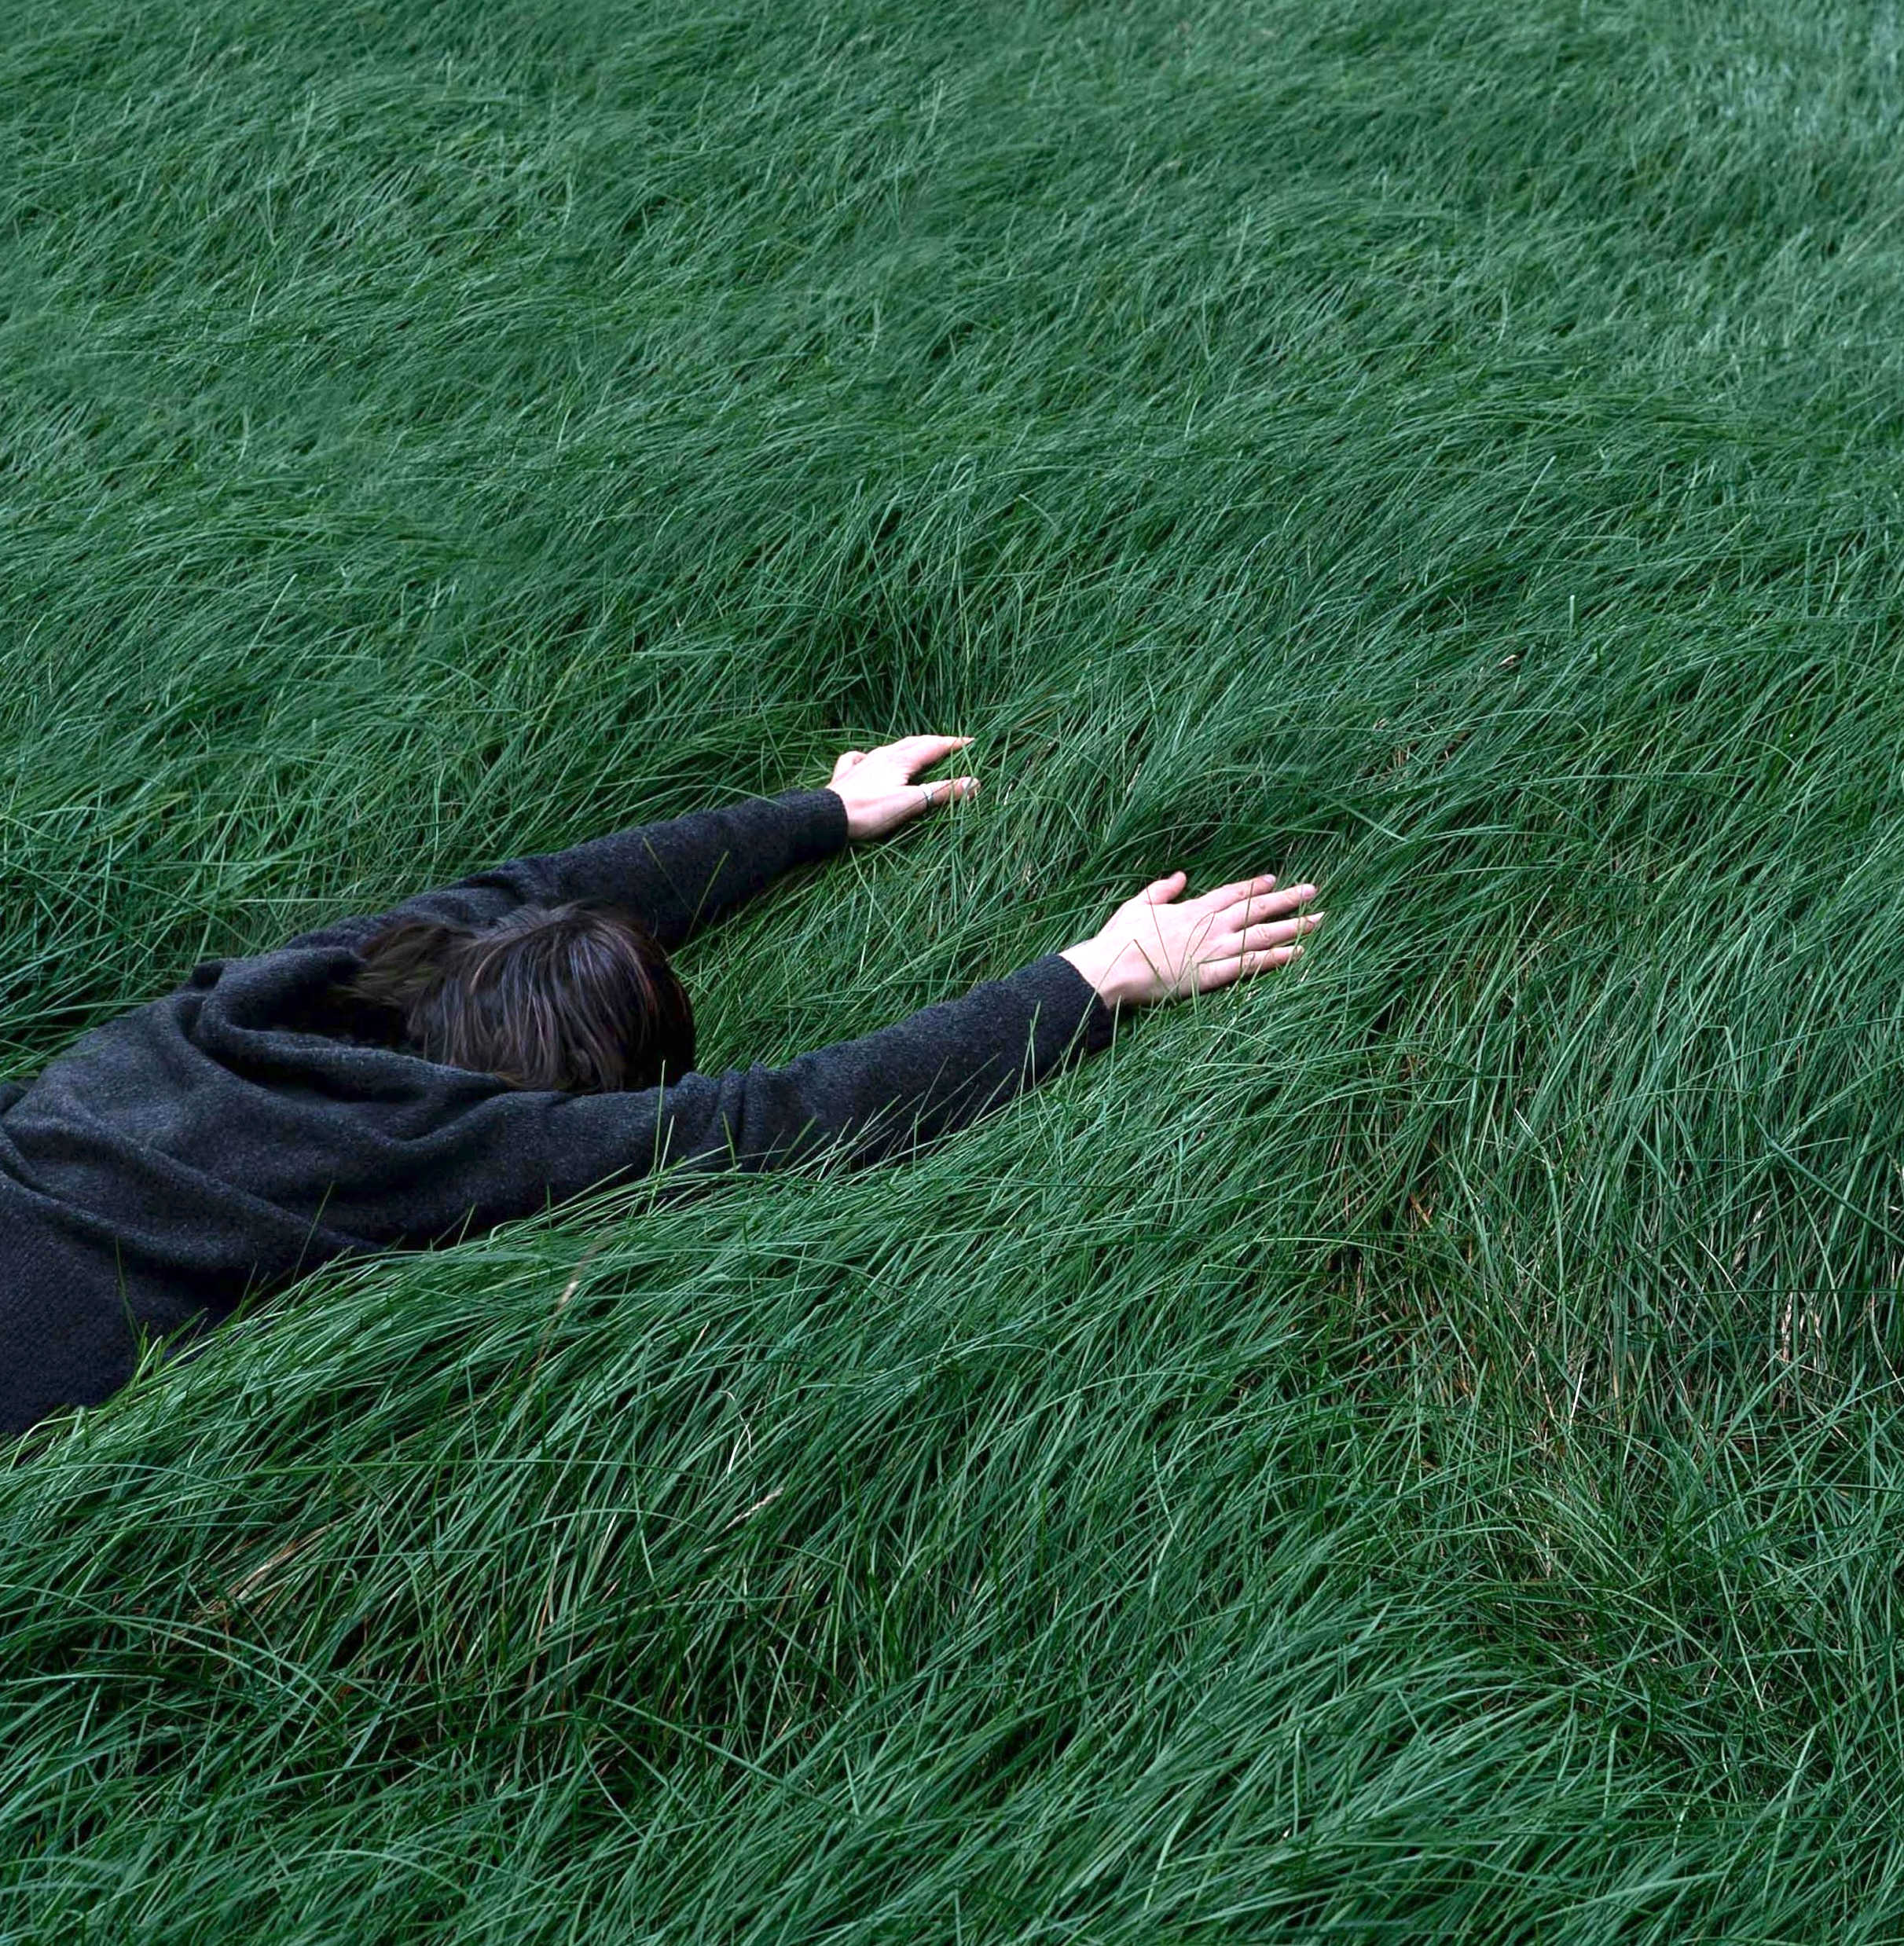
…nope.
Photo by Sonia Dauer on Unsplash
Notes:
I revisited my thesis and it did not work!

Slide 9
So, I started fixing it. Was it easy?

Slide 10
Absolutely not!

Slide 11
Why?

Slide 12
The main issue: I was not building a project for future users—including me in the future

Slide 13
Problems:

Slide 14
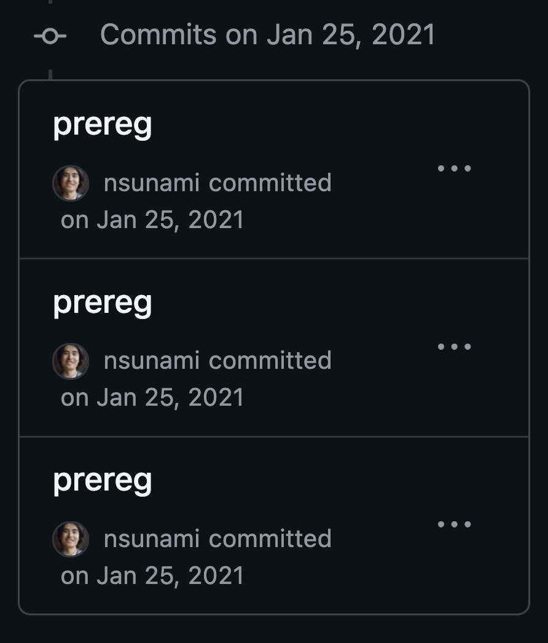
Committing with meaningless commit messages
*Nowadays, I try to follow Conventional Commits
conventionalcommits.org

Slide 15
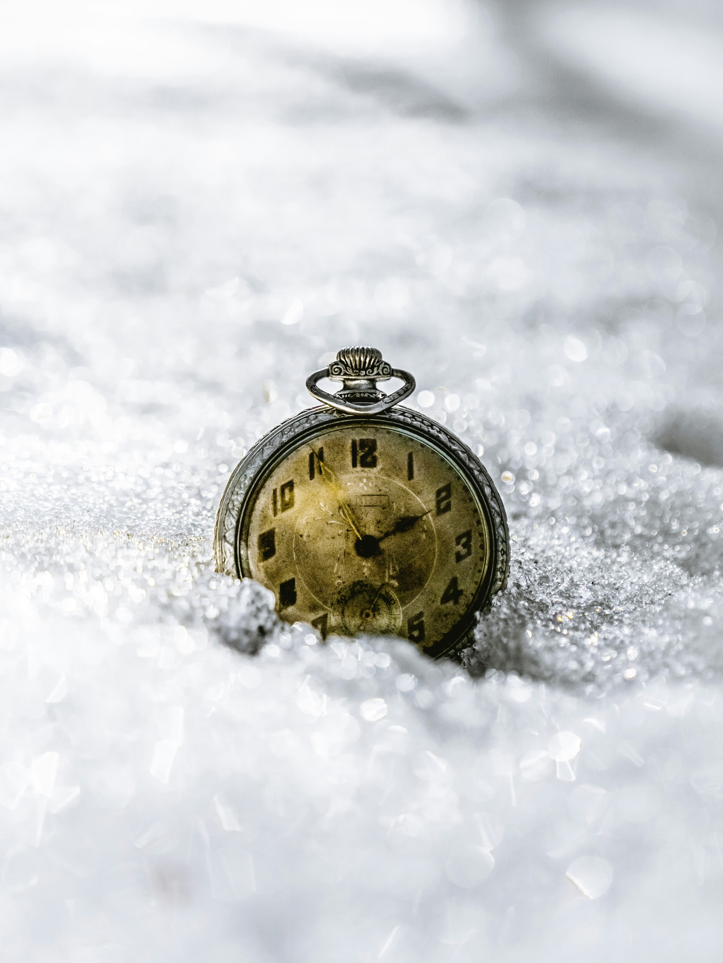
When I wrote this code, God and I knew what it meant.
1`
“
Now, only God knows.
Photo by Kevin Andre on Unsplash

Slide 16
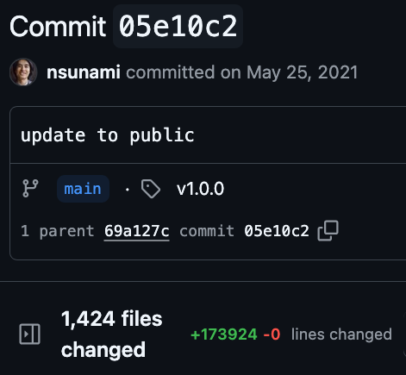
Bundling multiple changes to one commit

Slide 17
The issue was about documentation

Slide 18
I wish my past self had a documentation for me

Slide 19
Documentation that you make as you work on the code, on-the-fly

Slide 20
Usually, we think documentation as something written in files
Comments
README
Function Docs

Slide 21
But, we also create on-the-fly documentation via using Git & GitHub*
Commit messages
Issues
Pull requests
*Or similar services like Gitlab, Gitea, and Forjejo

Slide 22
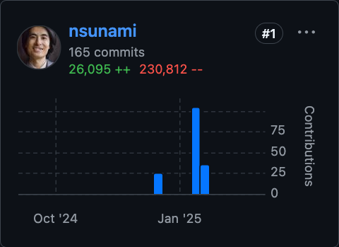
After a month of work & 250k lines of change, it works again
But it could have been easier with better documentations

Slide 23
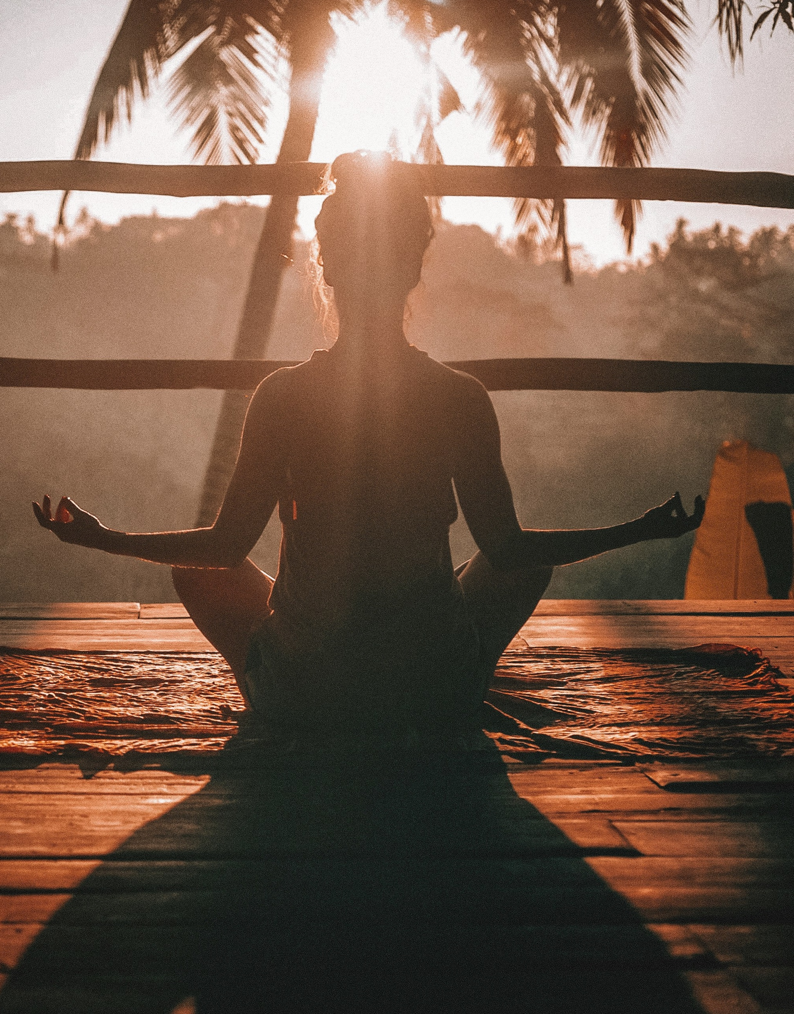
Practice self-care, and use Git effectively
Using Git can be a gift for yourself
Photo by Jared Rice on Unsplash

Slide 24
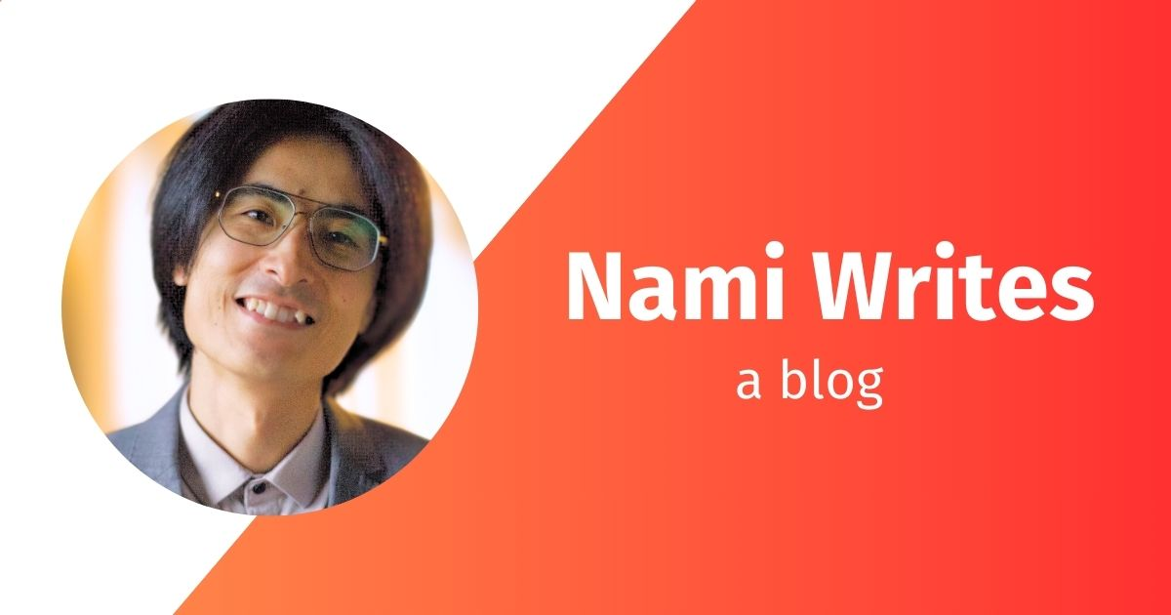
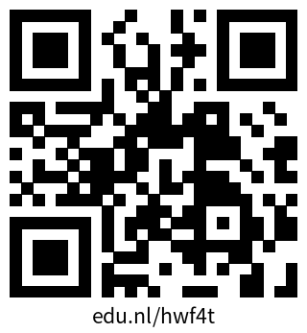
My blog post for the full story of me fixing my dissertation
https://blog.namisunami.com/b38e5ff5/

Slide 25

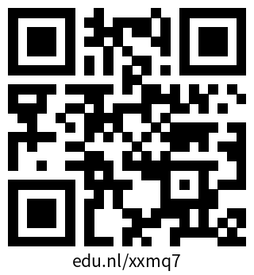


Special thanks:
Join the Community
openscience@tue.nl
sites.google.com/view/osceindhoven
Notes:
If you would like to join a community of like-minded people at TU/e – you are welcome to become a member of the OS community Eindhoven.
It’s a space where you can exchange experiences with fellow researchers, learn something new and/or share your knowledge with others.
Starting from the new academic year, we are going to have budget from NWO which will help the community to develop and grow and you can be part of it.

Slide 26
Footnotes
Icon Sources
Lucide.dev
SVGrepo.com
Image Source
Unsplash
This work is marked with CC0 1.0

